Slide 1

Topic for the class:INTRODUCTION Sensors Unit II : Introduction to Sensors, Microcontrollers, and Their Interfacing

Slide 2

Unit-2
Introduction to Sensors,Microcontrollers, and Their Interfacing:
Introduction to Sensor Interfacing,
Types of Sensors,
Controlling Sensors through Webpages,
Microcontrollers

Slide 3
Introduction to Sensors

Slide 4
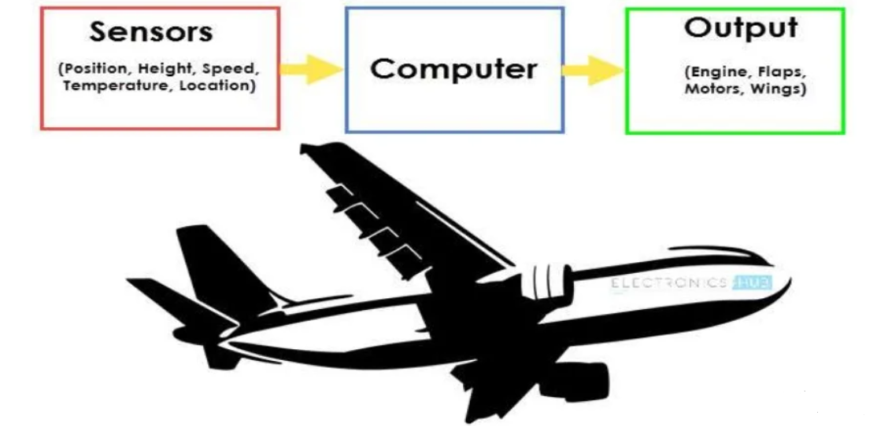

An Automatic Flight Control system consists of several sensors for various tasks like speed control, height, position,doors,obstacle,fuel,maneuvering and many more.
A computer takes data from all these sensors and processes them by comparing them with pre-designed values. The computer then provides control signal to different parts like engines,flaps,ridders etc. That help in a smooth flight.
The combination of sensors ,computers and Mechanics makes it possible to run the plane in Autopilot Mode.
All the parameters i.e., sensors (which give inputs to the computers ),the computers(the brain of the system) and the mechanics(the outputs of the system like engines and motors) are equally important in building a successful automated system.

Slide 5
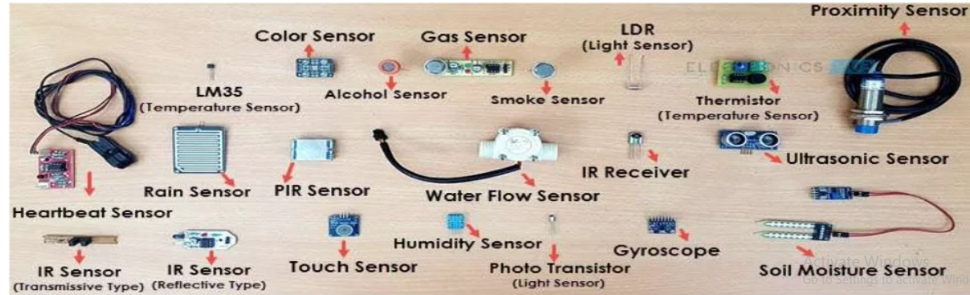
What is a Sensor?
Sensor as an input device which provides an output (signal) with respect toa specific physical quantity(input).
The term “Input Device” in the definition of a sensor means that it is part of a bigger system which provides input to a main control system (like a processor or a microcontroller).
Another unique definition of a sensor is as follows: it is a device that converts signals from one energy domain to electrical domain.

Slide 6
Classification of sensors:
In the first classification of the sensors ,they are divided in to Active and Passive.
Active sensors are those which require an external excitation signal or a power signal.
Passive sensors on the other hand do not require any external power signal and directly generates output response.
The final classification of the sensors are Analog and Digital Sensors.
Analog sensors produce an analog output i.e., a continuous output signal with respect to the quantity being measured.
Digital Sensors in contrast to Analog sensors work wit discrete or digital data. The data in digital sensors which is used for conversion and transmission ,is digital in nature.

Slide 7
Introduction to Sensor Interfacing

Slide 8
Introduction to Sensor Interfacing
There are numerous sensors in the world, and it is essential to have a knowledge about them for building a complete /comprehensive IoT system.
The concept of IDE is used in IoT systems.
Integrated Development Environment (IDE) is a set of software components and modules which provide the software and hardware environment for developing and prototyping.
An IDE enables the codes development on a computer, and later on enables download of the codes on the hardware platform.
IDE enables software that communicates with the Internet web server or cloud service.
Arduino IDE supports most of the available embedded boards, selection of board from the available menu is also important for proper sensor interfacing.

Slide 9
Types of Sensors
Gas Sensor (MQ2/MQ05)
Obstacle sensor
Heartbeat Sensor
Ultrasonic Sound Sensor
Gyro Sensor
LDR Sensor
GPS Sensor
Colour Sensor
pH Sensor

Slide 10
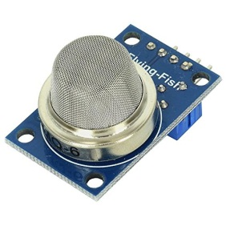
Gas sensor – MQ-02/05
This sensor is capable of detecting H2, LPG, CH4, Alcohol and smoke.
Due to its high sensitivity and fast response time, measurements can be taken as quick as desired.
When any flammable gas flows through this sensor the coil inside this sensor burns and so, the resistance of the coil decreases. Hence, the output voltage starts increasing, which can be detected using a micro controller.
Note: MQ-05 is not sensitive to smoke. Hence, MQ-02 is preferred for smoke detection applications. Also, MQ-02 is not very good for detecting the low level LPG presence.

Slide 11
The greater the gas concentration, the greater the output voltage.
The lower the gas concentration, the lower the output voltage.
The MQ-02 also has a potentiometer which helps to adjust the sensitivity to smoke.
With POT, One can change how sensitive it is to smoke. This is called calibration.

Slide 12
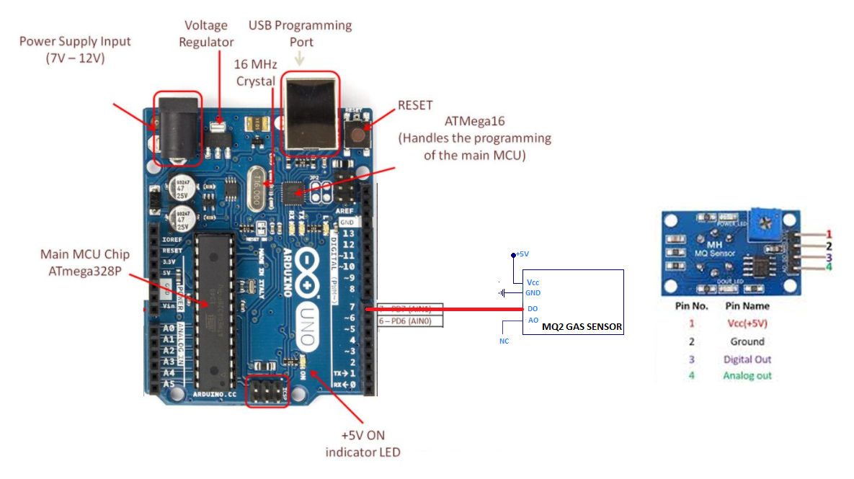
pin details AND CONNECTION DIAGRAM

Slide 13
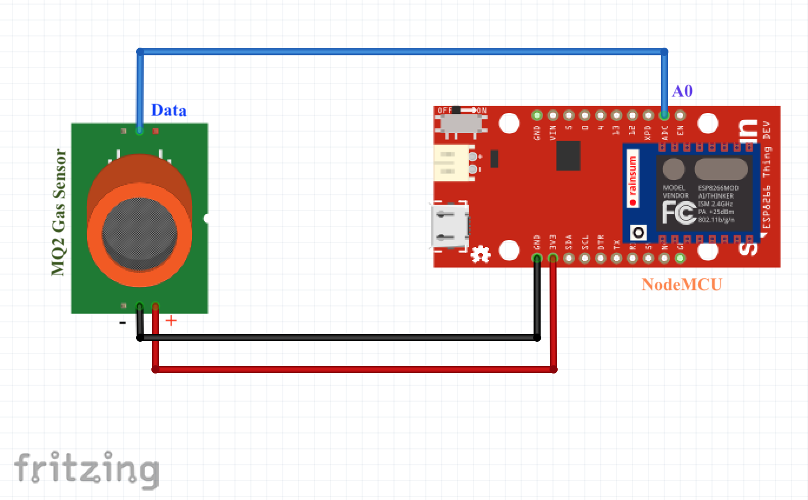
Connection Diagram of NodeMCU to MQ-02 sensor
MQ-02 has VCC(power) ,Ground followed by Analog and Digital pins.
Data can be Read from Analog/digital based on the requirement and necessity .
A0 pin is connected to data(Analog Pin) of MQ-02 .
Ground & VCC are connected at both the ends

Slide 14
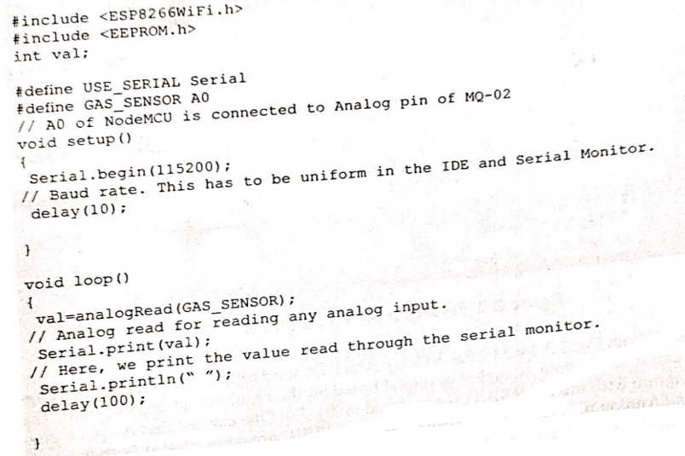
Code to Interface A0 of NodeMCU with MQ-02
Video link demo:https://youtu.be/BeMy4hepOVI

Slide 15
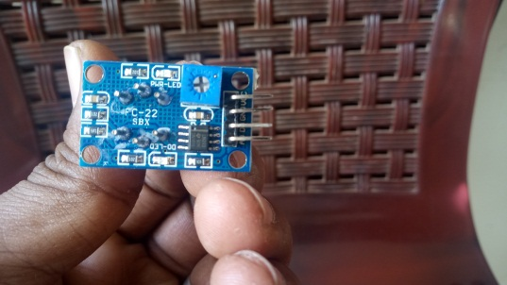
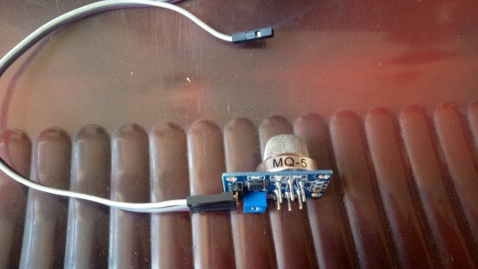
MQ05 Working
Most suitable for H2, LPG, Alcohol detection.
Used in Home / Industry.
Highly sensitive and can be tuned further as well. (With POT).
Analog Sensor – So A0 of the MCU to be used. (Support for Digital Output is available in few latest versions)
The output voltage from the Gas sensor increases when the concentration of gas increases.
Suitable for LPG detection.

Slide 16
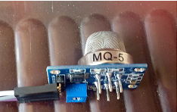
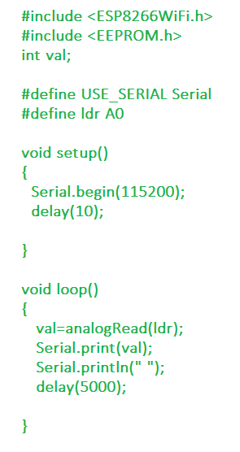
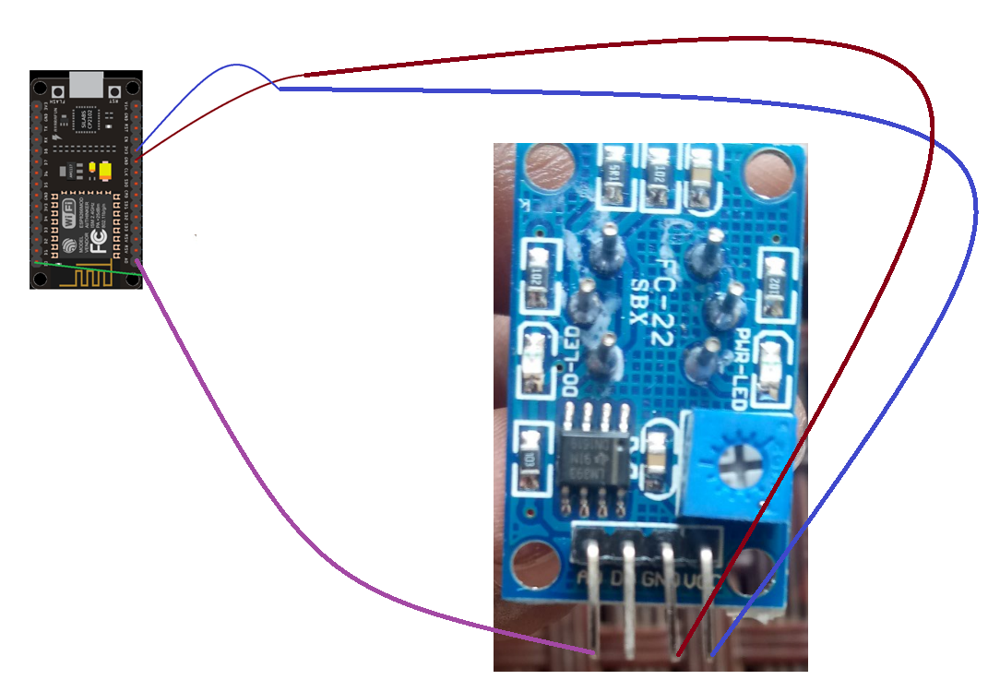
MQ05 Sensor to NODEMCU
https://youtu.be/BeMy4hepOVI

Slide 17
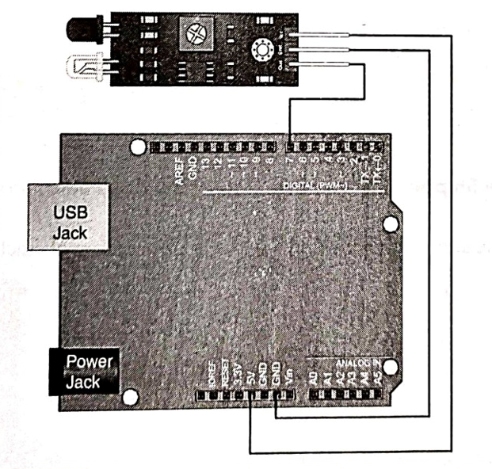
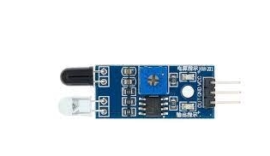
Obstacle Sensor:
In real time Applications IR sensors are used for detecting obstacles.
For example, a Robot is deployed to detect the obstacles in the path.
The Robot has to detect and alert the presence of an obstacle. So, IR sensors are used which give either Zero or one as its digital output based on the presence of the obstacle.

Slide 18
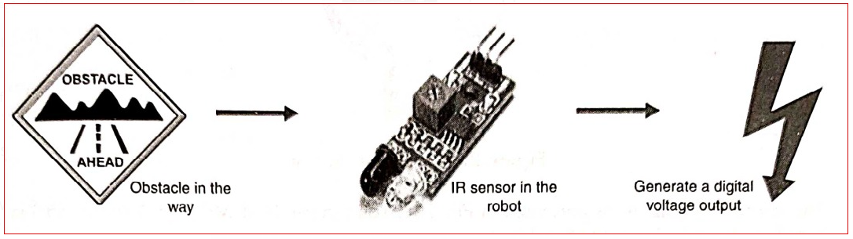
The Sensor gives an Output Voltage when it detects an obstacle in front of it of the order of a few millivolts.
This generated voltage is digital (1 or 0) which will let the robot to know whether an obstacle is present or not.

Slide 19
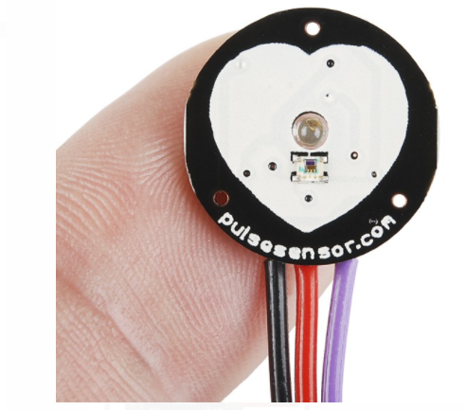
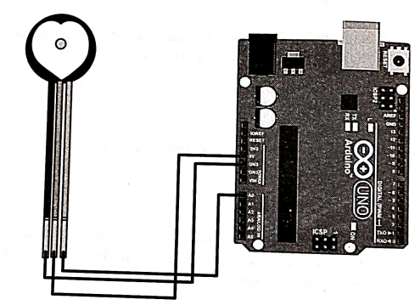
HeartBeat Sensor
There are many Applications that use Heartbeat sensor such as wearable applications that monitor a person's heartbeat accurately .
The applications are mostly in health care domain and the sensor is inexpensive.
This sensor is interfaced with Arduino uno board/NodeMCU and the data is loaded onto the Cloud.

Slide 20
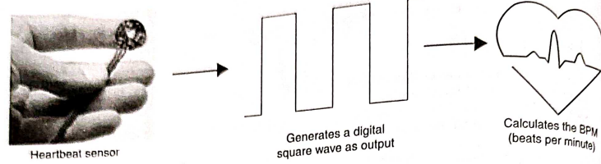
Usage and measurement of BPM using sensor
This sensor outputs a signal which must be analyzed using a special method called pulse width Modulation(PWM).
All PWM will be done by the Arduino using the analog read command.

Slide 21
Topic for the class:INTRODUCTION Sensors Unit II : Introduction to Sensors, Microcontrollers, and Their Interfacing Date & Time:17.02.2022 @11:00 to 11:50AM
Mr. S.Sri Surya Srikanth
Assistant Professor
Department of EECE
GITAM Institute of Technology (GIT)
Visakhapatnam – 530045
Email: ssathira@gitam.edu

Slide 22
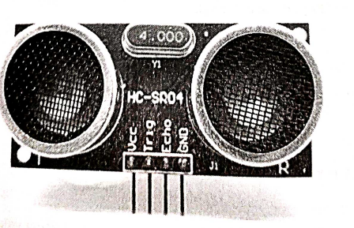
Ultrasonic Sound Sensor(>20KHz)
Ultrasonic sensor is used to measure the distance of an object.
These sensor emanate ultrasonic sound which travels and hits the surrounding object(trigger pin generates input signal).
The received ultrasonic pulse is captured by the sensor(echo pin detects output signal).
This sensor can only measure the distance from the object and cannot determine what type of object it is.
A simple application of ultrasonic sound sensor is automatic car parking.

Slide 23
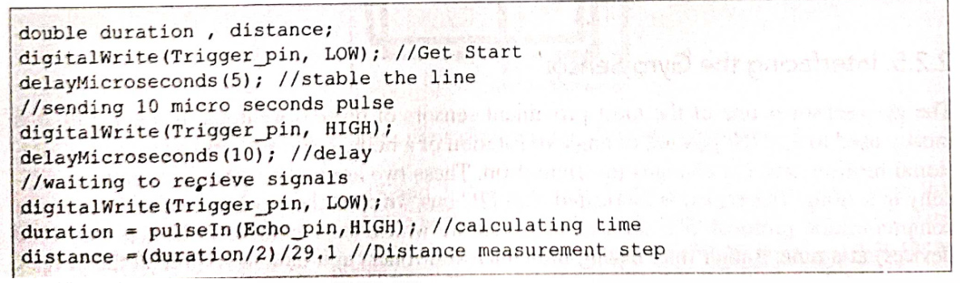
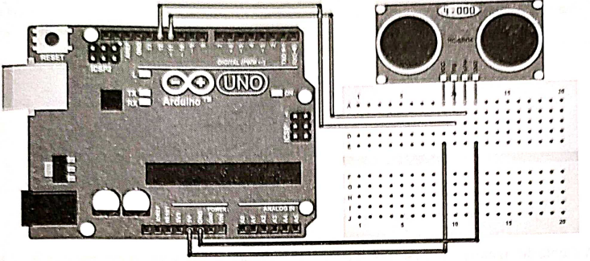
Ultrasonic sensor interface

Slide 24
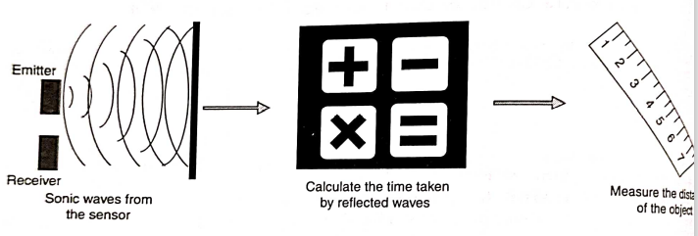
Working of an ultrasonic sensor in real time
The target should be aligned in the straight path with respect to ultrasonic sensor.
so that the transmitted signals which strike the target are reflected back to the receiver without any deviations.
As the waves travel at 45 degrees so the target is placed in a straight line.
Corresponding distance is indicated on the scale.

Slide 25
Applications of Ultrasonic Sensors
Robotic sensing
Stacking height control
Loop control
Liquid level control
Full detection
Counting people/people detection
Presence detection
Detecting breaks in threads or wires
Box sorting
Contouring or profiling
Irregular parts detection
Tank level detection
Many applications on the production line
Distance measurement - regardless of an object's shape, colour or surface texture

Slide 26
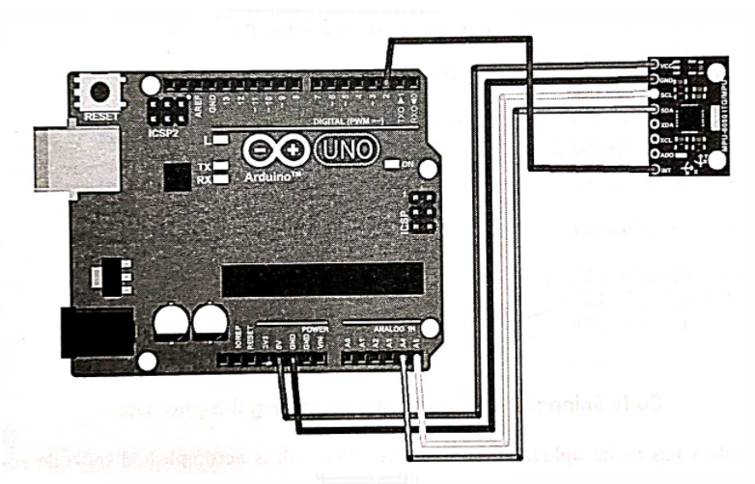
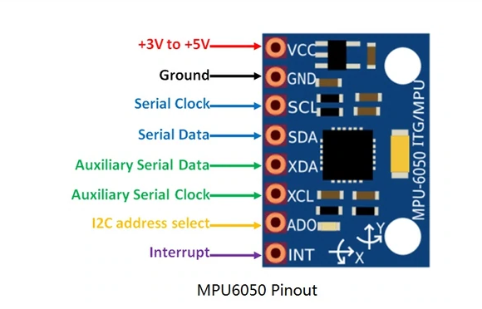
Gyro Sensor
The gyro sensor is one of the most prominent sensor of present wearable technologies.
It is mostly used to find the posture or angle of rotation of a body.
These sensors can sense rotational motion, and changes in orientation.
These two are motions that humans have difficulty in sensing.
This sensor is fabricated with I2C(inter integrated circuit) bus, which is the most sophisticated two-way communication protocol.
It is used to communicate with many devices(say 10 devices) at a time.
Rather than having 1000 microcontrollers at a time to control all the devices instead it can be done with just one microcontroller.

Slide 27
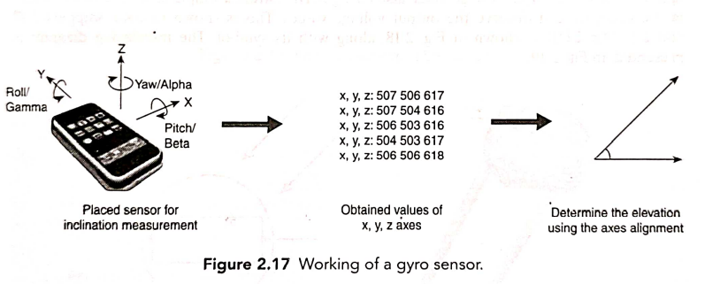
Working of a Gyro sensor
In order to detect a fall of a person , it can be recognized through visionary inputs ,but the task becomes complex when the falling is to be detected with sensors and IoT implementation .
So, by monitoring the posture of a person's body gives better insights into when the person will fall. In these applications gyro sensors are used.

Slide 28
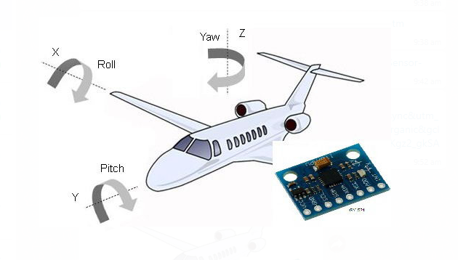
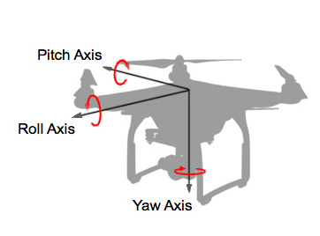
Applications of Gyroscope
Angular Velocity Sensing: This senses the amount of angular velocity produced.
It is used in measuring the amount of motion. For example checking athletic movement.
2. Angle sensing : This senses angular velocity produced by the sensors own
movement.
Angles are detected via integration operation by a CPU.
The angle moved is fed to and reflected in an application.
Examples include car navigation systems, game controllers and cellular systems.
3.Control Mechanism : This senses vibration produced by external factors, and
transmits vibration data as electrical signals to a CPU.
It is used in correcting the orientation or balance of an object.
Examples include camera-shake correction and vehicle control.

Slide 29
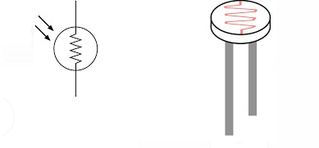
LDR Sensor:
LDR is a component that has a variable resistance which changes with light intensity that falls upon it.
Hence LDRs are sensors that are employed where there is a necessity for monitoring the intensity of light.
Since resistance of the sensor change with light intensity the output value also changes.

Slide 30
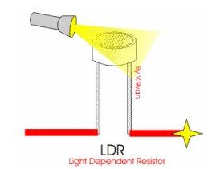
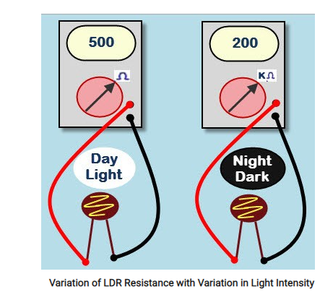
This resistor works on the principle of photo conductivity. It is nothing but, when the light falls on its surface, then the material conductivity reduces and also the electrons in the valence band of the device are excited to the conduction band.
These photons in the incident light must have energy greater than the band gap of the semiconductor material. This makes the electrons to jump from the valence band to conduction.
These devices depend on the light, when light falls on the LDR then the resistance decreases and increases in the dark. When a LDR is kept in the dark place, its resistance is high and, when the LDR is kept in the light its resistance will decrease.

Slide 31
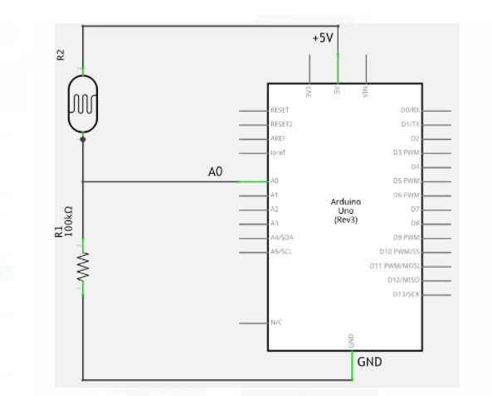
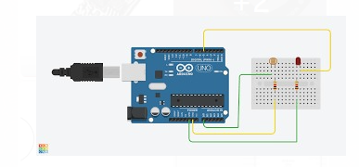
Connections for LDR & Pin configuration:

Slide 32
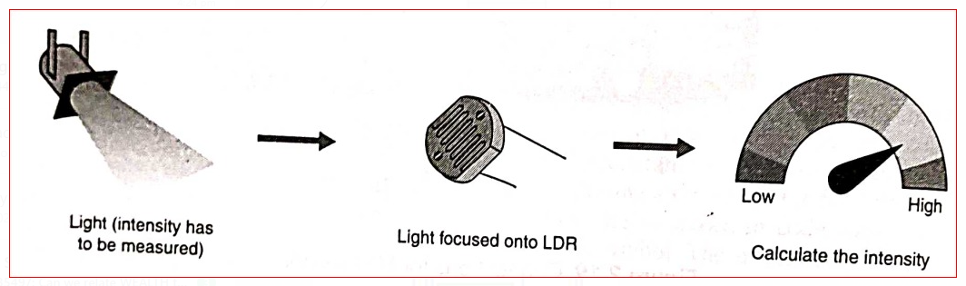
Working of LDR:
These devices depend on the light, when light falls on the LDR then the resistance decreases and increases in the dark. When a LDR is kept in the dark place, its resistance is high and, when the LDR is kept in the light its resistance will decrease.

Slide 33
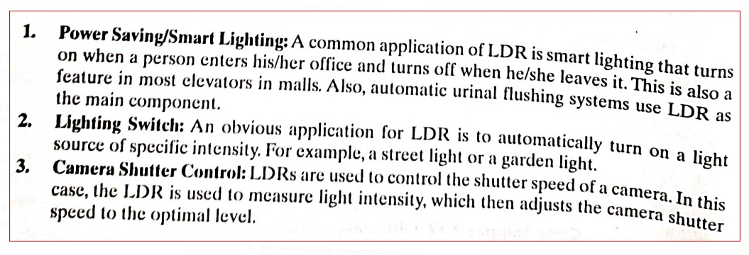
Typical Applications of LDRs:

Slide 34
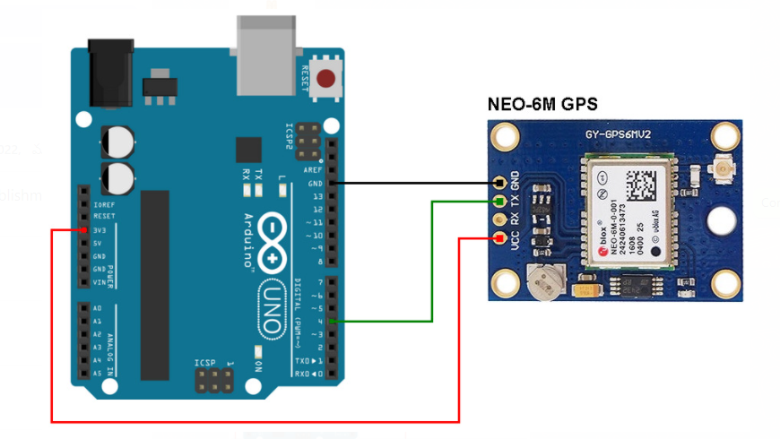
GPS Sensor
Global Positioning System (GPS) is a satellite-based system that uses satellites and ground stations to measure and compute its position on Earth.
GPS is also known as Navigation System with Time and Ranging (NAVSTAR) GPS.
GPS receiver needs to receive data from at least 4 satellites for accuracy purpose. GPS receiver does not transmit any information to the satellites.
GPS Sensors are widely used for acquiring the location data of the place where the sensor is present(OLA /UBER App for tracking cars).
The data from the sensor is acquired in NMEA(National marine Electronics Association) format ,which is used by marine department for communication.
GPS module is used in places, where a location tag is to be added. This is an economical method for receiving GPS data.
VCC: Power Supply 3.3 – 6 V
GND: Ground
TX: Transmit data serially which gives information about location, time etc.
RX: Receive Data serially. It is required when we want to configure GPS module.
Notes:
https://www.electronicwings.com/sensors-modules/gps-receiver-module

Slide 35
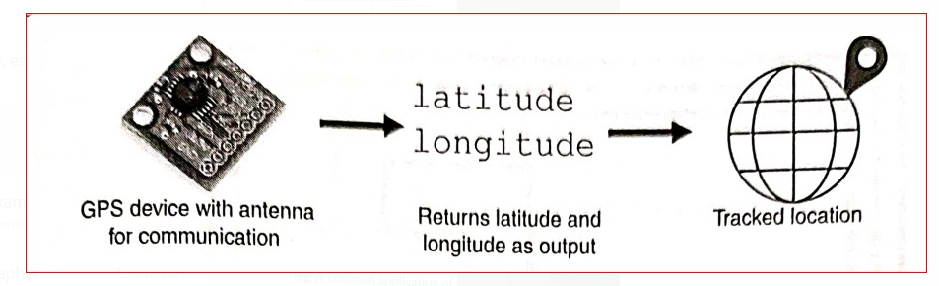
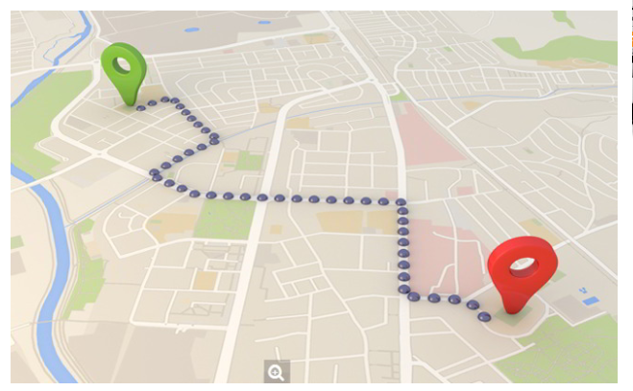
Scheme for live tracking of vehicle
GPS sensors are used mostly for purposes such as person/Vehicle tracking around the globe.
This sensor is very simple and cheap. Tracking systems are mostly used by fleet operators for tracking a vehicle location, routing and others.
This is a very good method for preventing our vehicles from stolen. This tracking system sends us the geographical coordinates and by using these coordinates we can track our vehicle position on electronic maps using internet.
By using these tracking systems, real time information about transportations can be shared(information or position of bus/taxi/cab with passengers). Means passengers can see the real time of arriving bus/taxi/cab on Mobiles(RedBus,AbhiBus,IRCTC etc..,).

Slide 36
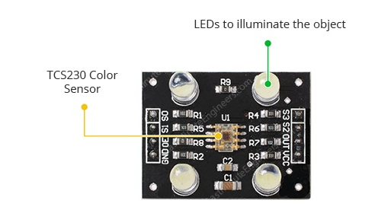
Colour Sensor:
A colour sensor is a type of "photoelectric sensor" which emits light from a transmitter, and then detects the light reflected back from the detection object with a receiver.
They are used generally to detect the RGB coordinates of a particular colour.
The colour sensors works by shinning a white light on an object and then recording the reflected colour through Red, Green and Blue colour filters.
The photodiode converts the amount of light to current. These RGB values are further processed to find the exact colour combination.
At the heart of the module is an inexpensive RGB sensor chip from Texas Advanced Optoelectronic Solutions – TCS230. The TCS230 Color Sensor is a complete color detector that can detect and measure an almost infinite range of visible colors.
he sensor itself can be seen at the center of the module, surrounded by the four white LEDs. The LEDs light up when the module is powered up and are used to illuminate the object being sensed. Thanks to these LEDs, the sensor can also work in complete darkness to determine the color or brightness of the object.
The TCS230 operates on a supply voltage of 2.7 to 5.5 volts and provides TTL logic-level outputs.

Slide 37
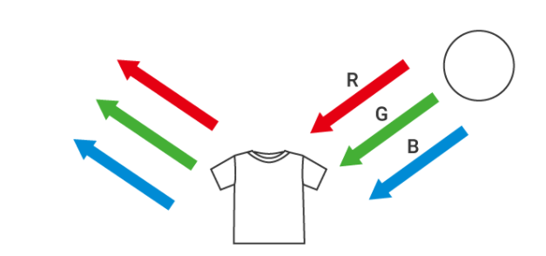
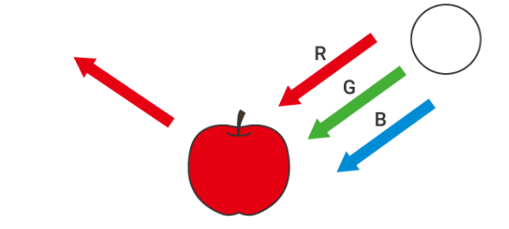
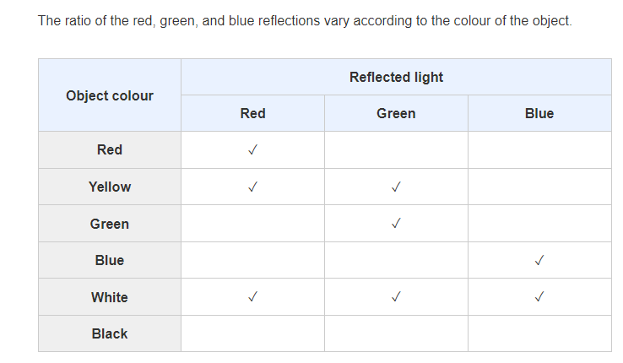

Slide 38
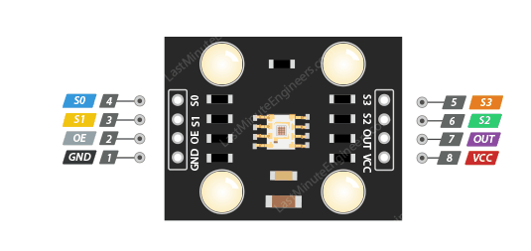
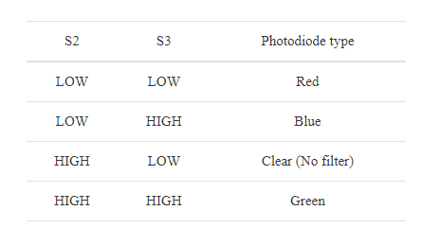
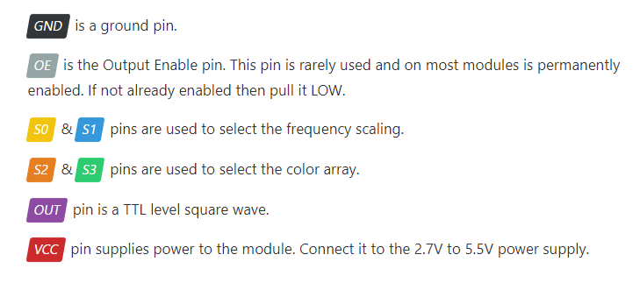
Pin configuration

Slide 39
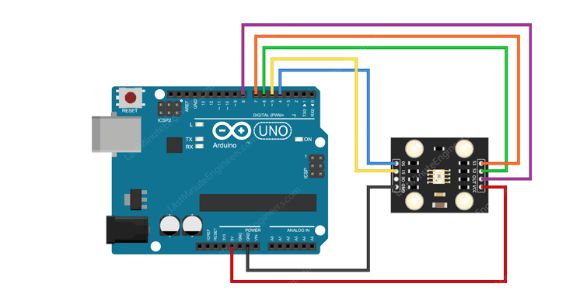
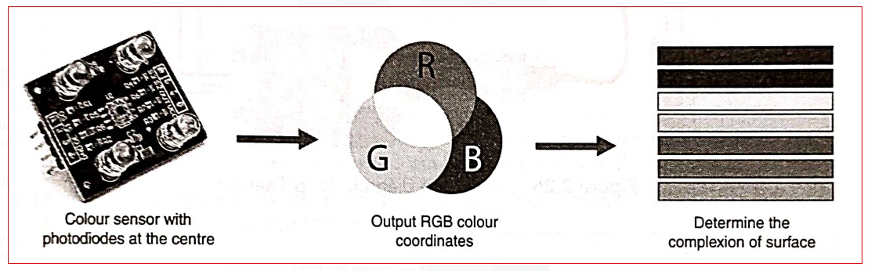
Connection diagram for Colour Sensor
The S0-S3 pins act as outputs. These pins will be used to select the frequency scaling and the color we wish to address.
An internal current-to-frequency converter converts readings from photodiodes into a square wave whose frequency is proportional to the intensity of the chosen color. The range of the typical output frequency is 2HZ~500KHZ.
The S0 and S1 pins are used to set the frequency scaling to 20%, which is a common value when using this color sensor with an Arduino.
The frequency can be scaled to three different preset values of 2%, 20% or 100%.
Next, the sensor's Output pin is defined as an input to the Arduino, this is where we will receive the square wave.

Slide 40
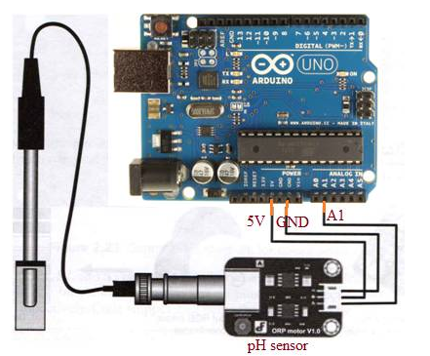
pH sensor:
The sensor which detects hydrogen ion (H+) concentration of liquid is known as pH sensor. This indicates acidity or alkalinity of a liquid.
When pH sensor is immersed in liquid solution, smaller ions get penetrated in the boundary area of the glass membrane where as larger ions remain in the liquid solution. This develops potential difference. pH meter measures potential difference between electrodes.
As shown below pH sensor output is connected with analog read input of the arduino board. The pH sensor provides different analog outputs for different liquid solutions. By knowing pH value of known solution such as water one can easily determine pH value for other liquid solutions.
Vcc (+ pin of pH sensor side) - 5V (Arduino side)
GND (- pin of pH sensor side) - GND (Arduino side)
OUT (A pin of pH sensor side) - A1 (Arduino side)

Slide 41
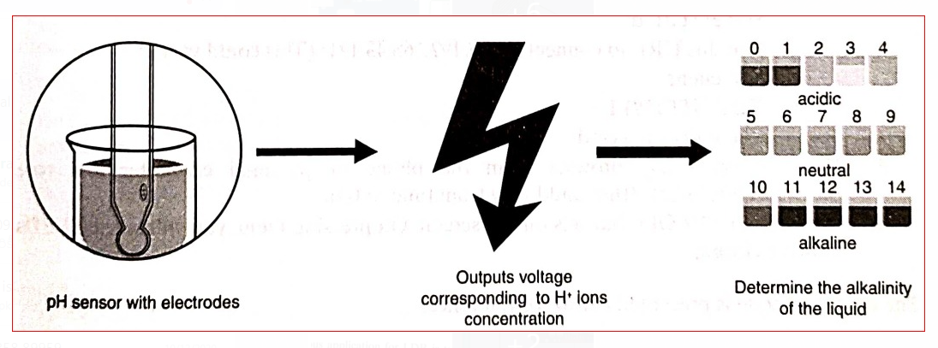
Determining the pH value using pH sensor
The pH Sensors are mostly used in laboratories where acidity test is necessary to be performed inorder to determine the nature of a liquid.
Acidity test consumes a lot of time if done without a pH Sensor.
The difference between an alkaline substance and an acidic substance is very important for any company that uses a cooling tower, boiler, manufacturing processes, swimming pool control, and various types of environmental monitoring.
The human body has a standard pH level of 7.4, which is essential for the body to run effectively.

Slide 42
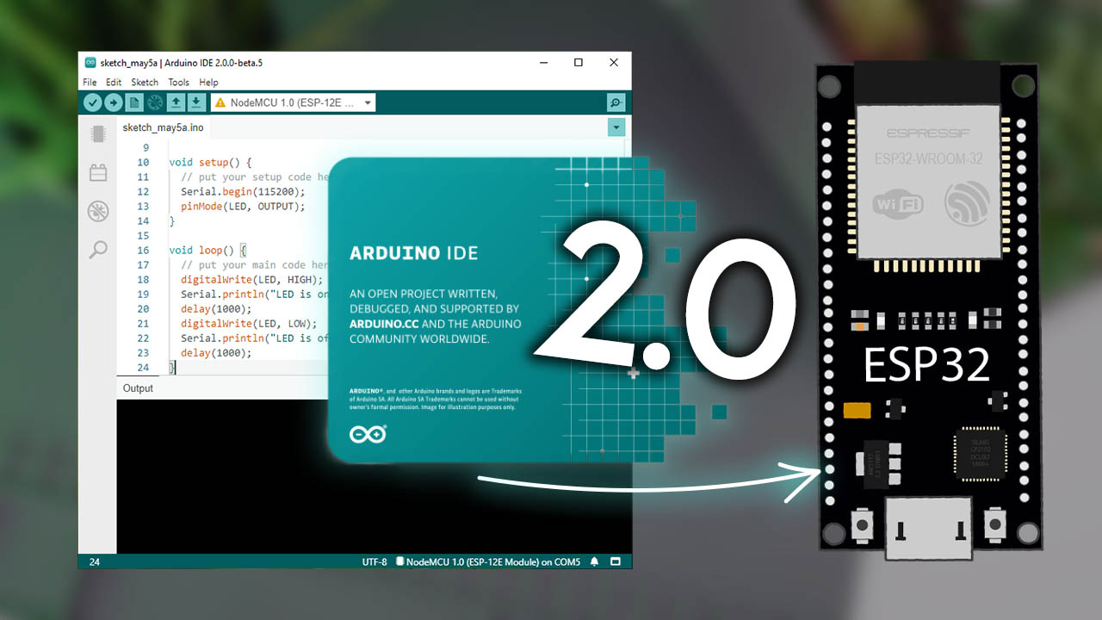
Flow representation for Controlling Sensors through Webpages
Personal computer
NodeMCU
(wifi module)
Thinger.io(open source cloud platform)

Slide 43
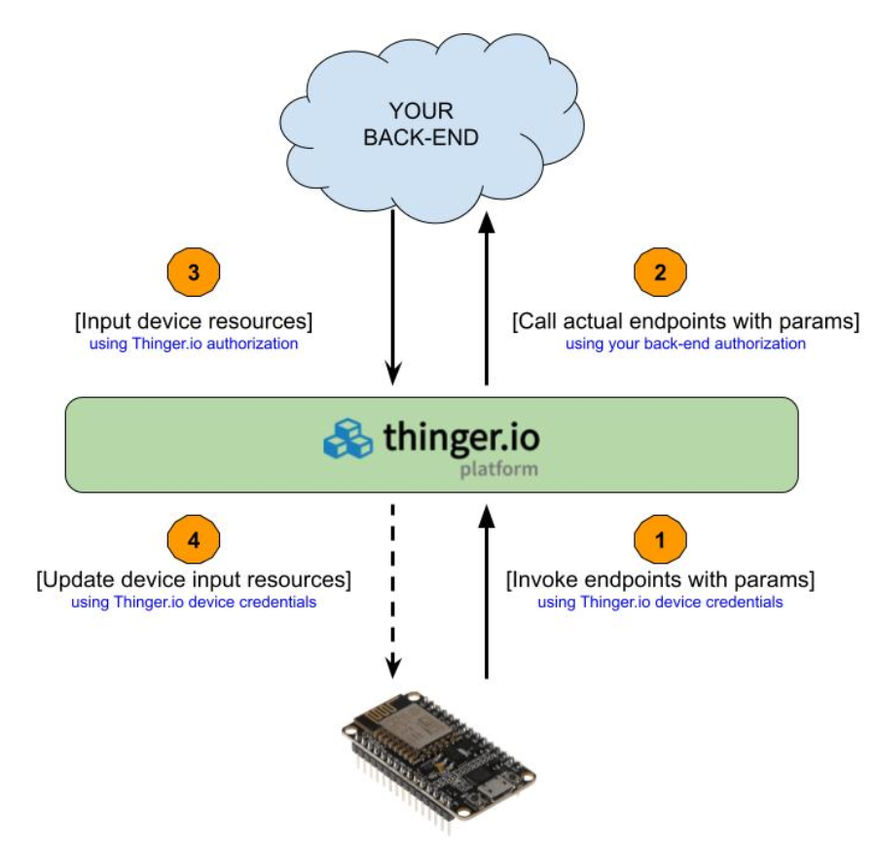
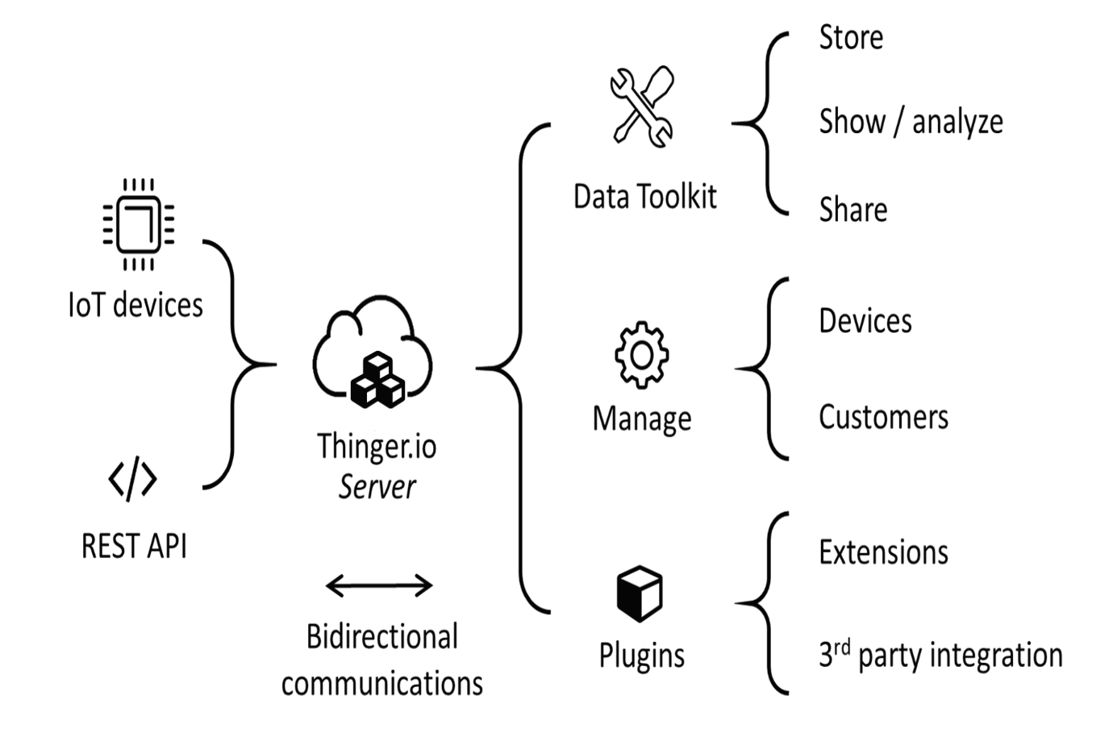
Flow representation for Controlling Sensors through Webpages

Slide 44


Controlling Sensors through Webpages
LED is controlled through a webpage which can be related to control the functioning of a motor/fan through a webpage.

Slide 45

Controlling LED with a Webpage
Creation of Webpage which is used to remotely control an LED with the help of NodeMCU is discussed .
Before running the code it is important to follow the steps that will guide to connect the LED to NodeMCU.

Slide 46




Slide 47
MICROCONTROLLER

Slide 48

8051:Architectural layout

Slide 49

Features supported by 8051:

Slide 50

Specifications of 8051 microcontroller & its family
8052 is regraded as a developed version of 8051.
8031 is not as good as the other two as there is no in-built ROM available.
Though intel manufactured 8051 it has permitted other companies to manufacture 8051 having a compatible instruction set.
Many organizations sch as Atmel ,Dallas Semiconductors ,Analog Devices & Texas instruments are also into 8051 production and distribution which supports same instruction set and features.

Slide 51
There are two broad categories of memory
1.Program memory.
2.Data Memory.
Program Memory:
Program memory typically refers to flash memory when it is used to hold the program (instructions) .
Program memory is a non-volatile memory.
Program memory may also refer to a hard drive or solid state drive (SSD).
It is used to store Boot up programs , interrupt service routines(ISR) & Macro functions.
In 8051,a 4k byte of internal program memory is available.

Slide 52

Data Memory
The data RAM (Random Access Memory) is the data space that is used for temporarily storing constant and variable values that are used by the microcontroller during normal program execution.
Here we will see the data memory structures of 8051 microcontroller. The internal data memory of 8051 is divided into two groups. These are a set of eight registers, and a scratch pad memory. These eight registers are R0 to R7. The address range 00H to 07H is used to access the registers, and the rest are scratch pad memory.
8051 Provides four register bank, but only one register bank can be used at any point of time. To select the register bank, two bits of PSW (Program Status Word) are used.

Slide 53


Data Memory
8051 is organized neatly with 256 bytes of memory, which are split as follows :
a. First 128 bytes :00H to 1FH register banks .
b. 20H to 2FH bit addressable RAM.
c.30H to 7FH general purpose RAM(General purpose data can be stored here).
d.Last 128bytes:80H to FFH Special function register (SFRs).

Slide 54

Internal Data Memory Organization of Intel 8051
When all of the register banks are being used, the scratch pad area will be 20H to 7FH. But from 20H to 2FH (16 bytes or 128 bits) can be used as bit addressable RAM. By using some simple instructions with 8-bit memory address we can check the bit addressing.
For an example the instruction CLR 6FH, using this instruction it clears the location 6FH. As we know the 8-bit address can locate 256 different locations, but here only 128-bits are addressable. Another section of bit addressable locations is 80H to FFH. The remaining locations (30H to 7EH) of the RAM can be used to store variable data and stack.

Slide 55
Registers used in 8051 Microcontroller
The register is the main part of the microcontrollers and processors that provide a fast way to collect and store data.
If we want to manipulate data with a controller or processor by performing addition, subtraction, and so on, we cannot do that directly in the memory, but it needs registers to process and store the data. Microcontrollers contain several types of registers that can be classified according to their content or instructions that operate in them.
Different Types of Registers in the 8051 Microcontroller
Register
A register is a small place in a CPU that can store small amounts of the data used for performing various operations such as addition and multiplication and loads the resulting data on the main memory.
Registers contain the address of the memory location where the data is to be stored. The size of the register is very important for modern controllers. For instance, for a 64-bit register, a CPU tries to add two 32-bit numbers and gives a 64-bit result.

Slide 56

Types of Registers
The 8051 microcontroller contains mainly two types of registers:
1.General-purpose registers (Byte addressable registers)
2.Special function registers (Bit addressable registers)
The 8051 microcontroller consists of 256 bytes of RAM, which is divided into two ways, such as 128 bytes for general purpose and 128 bytes for special function registers (SFR) memory.
The memory which is used for general purpose is called as RAM, and the memory used for SFR contains all the peripheral related registers like Accumulator, ‘B’ register, Timers or Counters, and interrupt related registers.

Slide 57

General Purpose Registers
The general-purpose memory is called as the RAM of the 8051 microcontrollers, which is divided into 3 areas such as banks, bit-addressable area, and scratch-pad area.
The banks contain different general-purpose registers such as R0-R7, and all such registers are byte-addressable registers that store or remove only 1-byte of data.

Slide 58

Banks and Registers
The B0, B1, B2, and B3 stand for banks, and each bank contains eight general-purpose registers ranging from ‘R0’ to ‘R7’.
All these registers are byte-addressable. Data transfer between general-purpose registers to general-purpose registers is not possible. These banks are selected by the Program Status Word (PSW) register.

Slide 59

PSW (Program Status Word) Register
The PSW register is a bit and byte-addressable register. This register reflects the status of the operation that is carried out in the controller.
The PSW register determines bank selection by an RS1 and RS0, as shown below. The physical address of the PSW starts from D0h and the individual bits are accessed with D0h to D7h.

Slide 60


Carry Flag (C): The Address of the Carry flag is D7. This carry flag is affected when the bit is generated from the 7th position. When C=0 carry resets ,C=1 carry sets.This is used frequently by the processor for arithmetic and shift operations.
Auxillary Flag(AC): The address of the auxiliary carry is D5. This auxiliary carry is affected when a bit is generated from the 3rd position to the 4th position.AC=0 auxiliary is reset,AC=1 auxiliary is set.This will be used in case of BCD related operations.

Slide 61

Overflow Flag (OV): The address of the overflow flag is D2. When a bit is generated from the 6th position to the 7th position, then the overflow flag is affected.
OV=0 overflow flag resets OV=1 overflow flag sets
Parity Flag (P):It will be set/reset based on the value (Numeric) present in the Accumulator. If it has odd number of 1’s then it is set otherwise it is set to zero, so it serves just as an indicator.
F0:It is a general-purpose bit that can be used by user as per their requirement .

Slide 62

RS1 and RS0:There are four register banks supported in 8051 and each of them has 8 registers from R0 to R7.The user has a flexibility of selecting those one of those banks by using register bank select options. The RS1 and RS0, the bits in the PSW register, are used to select different memory locations (bank0 to bank4) in the RAM.

Slide 63

Special Function Registers (SFR)
Special function registers are upper RAM in the 8051 microcontrollers. These registers contain all peripherally related registers like P0, P1, P2, P3, timers or counters, serial port, and interrupts-related registers.
There are 21 SFR’s available in 8051 microcontroller.
The SFR memory address starts from 80h to FFh. The SFR register is implemented by bit-address registers and byte-address registers.

Slide 64

The accumulator, B register, Po, P1, P2, P3, IE registers are bit-addressable register remaining all are byte-addressable registers.
Accumulator:
The accumulator which is also known as ACC or A is a bit as well as a byte-addressable register by an address of the accumulator. If you want to use a bit-addressable register, you can use a single bit (E0) of the register and you can use an 8-bit of the accumulator as a byte-addressable register. The accumulator holds the results of most Arithmetic and logical operations.

Slide 65

B-Register
The B-register is a bit and byte-addressable register. You can access 1-bit or all 8-bits by a physical address F0h. Suppose to access a bit 1, we have to use f1. The B register is only used for multiplication and division operations.

Slide 66

Port register:P0,P1,P2 & P3 these function registers are meant for accessing the available ports of 8051 and are useful in interfacing with the peripherals.
PCON:
The PCON or Power Control register, as the name suggests is used to control the 8051 Microcontroller’s Power Modes and is located at 87H of the SFR Memory Space. Using two bits in the PCON Register, the microcontroller can be set to Idle Mode and Power Down Mode.
During Idle Mode, the Microcontroller will stop the Clock Signal to the ALU (CPU) but it is given to other peripherals like Timer, Serial, Interrupts, etc. In order to terminate the Idle Mode, you have to use an Interrupt or Hardware Reset.
In the Power Down Mode, the oscillator will be stopped and the power will be reduced to 2V. To terminate the Power Down Mode, you have to use the Hardware Reset.

Slide 67

SCON (Serial Control):
The Serial Control or SCON SFR is used to control the 8051 Microcontroller’s Serial Port. It is located as an address of 98H.
Using SCON, you can control the Operation Modes of the Serial Port, Baud Rate of the Serial Port and Send or Receive Data using Serial Port.
SCON Register also consists of bits that are automatically SET when a byte of data is transmitted or received.

Slide 68


TCON (Timer Control):Timer Control or TCON Register is used to start or stop the Timers of 8051 Microcontroller. It also contains bits to indicate if the Timers has overflowed. The TCON SFR also consists of Interrupt related bits.
TMOD (Timer Mode)
The TMOD or Timer Mode register or SFR is used to set the Operating Modes of the Timers T0 and T1. The lower four bits are used to configure Timer0 and the higher four bits are used to configure Timer1.

Slide 69


IE (Interrupt Enable)
The IE or Interrupt Enable Register is used to enable or disable individual interrupts. If a bit is SET, the corresponding interrupt is enabled and if the bit is cleared, the interrupt is disabled. The Bit7 of the IE register i.e., EA bit is used to enable or disable all the interrupts.
IP (Interrupt Priority)
The IP or Interrupt Priority Register is used to set the priority of the interrupt as High or Low. If a bit is CLEARED, the corresponding interrupt is assigned low priority and if the bit is SET, the interrupt is assigned high priority.

Slide 70

Peripheral Data Registers
SBUF (Serial Data Buffer)
The Serial Buffer or SBUF register is used to hold the serial data while transmission or reception.

Slide 71

TL0/TH0 (Timer 0 Low/High)
The Timer 0 consists of two SFRs: TL0 and TH0. The TL0 is the lower byte and the TH0 is the higher byte and together they form a 16-bit Timer0 Register.

Slide 72

TL1/TH1 (Timer 1 Low/High)
The TL1 and TH1 are the lower and higher bytes of the Timer 0.

Slide 73
Data Pointer Register(DPH and DPL)
This is an imaginary register, and it is actually non-existent. It is a combination of data pointer high-byte(DPH) and data pointer low byte(DPL) registers. DPH and DPL are 8 bits each and can be combined or used along as well.
When a 16-bit data needs to be stored, data pointer(DPTR) can be used as register. Following instructions are meant for this purpose.
a. MOV DPTR, #DATA; will move the 16-bit data to DPTR.
b. INC DPTR; increments DPTR by 1.
The following instruction shows how DPH and DPL will be used by the controller.
c. MOV DPTR,#2312; After execution, DPH will have 23H and DPL will have 12H.
Since DPTR is a combination of DPH and DPL, it is not represented by a single address. They have their own addresses.

Slide 74
Stack Pointer, Program Counter
Stack Pointer (SP): Every microcontroller has a stack area for temporary storage purposes. One can access the stack through the stack pointer,which is an 8-bit register and usually referred to as stack pointer register. Instructions related to stack are POP,PUSH and MOV SP, #XX where XX is the MOV SP and #XX is the address where stack pointer should point.
Program Counter: This is a special register. It has no address. The address of the next instruction to be executed will be kept in PC. It is one of the two 16-bit registers available in 8051. It makes the job of the processor easier to navigate.

